Slide 1
Market data job analysis
Detect new trends and match consultants

Slide 2
Summary
Aim of the project
Current state
Next tasks
Requirements

Slide 3
I. Aim of the project
Gather and analyze job offers to succesfully match/recruit/train consultants.

Slide 4
I. Aim of the project
Utility:
Analyze the new trends of the market,
Improve the matching between the job offers and the consultants,
Save time reading both CVs and job offers,
Centralize all the data in one point for further analysis, speed and ease. Many other app could also use this data.

Slide 5
II. Current state
LinkedIn | Status
Log in | OK
Search | OK
Get data from job offer | OK
Analyze data | Status
NLP analysis | On Progress – OK
Power BI | On Progress

Slide 6
II. Current state
Excel

Slide 7
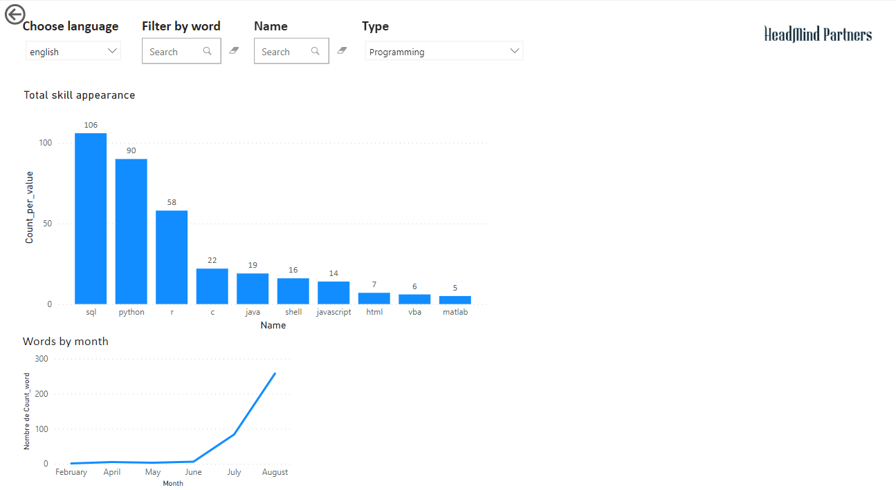
II. Current state
Power BI

Slide 8
III. Next tasks
Design a powerful and easy interface to be user friendly.
Implement, complete and publish a Power BI to give a single point of control for final users.
Nourish the dataset with multiple data sources.

Slide 9
IV. Requirements
Postgre SQL database on server
Advantages
Easy sharing data
Single point of connection
Remote access
Scalable size
Can handle simultaneous requests

